Slide 1


Name: Ferre Lo Castro, Iván
Date: 16 / September / 2023

Slide 2

Outline
Executive Summary
Introduction
Methodology
Results
Conclusion
Appendix

Slide 3
Executive Summary
Summary of methodologies:
The objective of predicting whether the first stage of the Falcon 9 rocket will land successfully., the following methodologies are performed:
Data on Falcon 9 first stage landings is collected, using a RESTful API and web scraping. The data is converted into a dataframe and some data cleaning and transformation operations are performed.
An interactive dashboard is built to analyze the launch records with Plotly Dash. An interactive map is also built to analyze the proximity of the launch site with Folium.
Machine learning is used to determine if the Falcon 9 first stage will land successfully. The data is divided into training data and test data to find the best hyperparameter for SVM, classification trees and logistic regression. The best performing method is found using the test data.
All activities are compiled in one place and the results and insights are delivered based on the results.

Slide 4
Executive Summary
Summary of results:
Explore, Transform and Clean Up
Making EDA (Exploratory Data Analysis) with SQL
we got some preliminary ideas on how each important variable would affect the success rate, we will select the characteristics that will be used in predicting success in the future module.
Finding an "success rate launch" location for building a launch site certainly involves many factors and hopefully we could discover some of the factors by analyzing the existing launch site locations
We create a k nearest neighbor object and then create a GridSearchCV object knn_cv with cv = 10. We adjust the object to find the best parameters from the dictionary parameters.
Decision Tree Classifier - best parameters: {'criterion': 'gini', 'max_depth': 8, 'max_features': 'sqrt', 'min_samples_leaf': 1, 'min_samples_split': 10, 'splitter': 'random’}; whit a accuracy : 0.8892857142857145
The best performing method is the decision tree classifier.
the accuracy of Decision Tree Classifier on the test data: 0,9444444

Slide 5
Introduction
Project background and context & Problems you want to find answers
Private space launches are an increasingly frequent and relevant activity in the field of space exploration and exploitation. This activity involves a series of technical and operational challenges that require the use of Data Science techniques and tools to optimize the use of resources and the efficiency of space operations.
This paper presents an analysis of data on private space launches performed by SpaceX, with the objective of predicting whether the first stage of the Falcon 9 rocket will land successfully.

Slide 6

Section 1

Slide 7
Methodology
Executive Summary
Data collection methodology:
Describe how data was collected
Perform data wrangling
Describe how data was processed
Perform exploratory data analysis (EDA) using visualization and SQL
Perform interactive visual analytics using Folium and Plotly Dash
Perform predictive analysis using classification models
How to build, tune, evaluate classification models

Slide 8
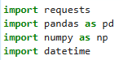
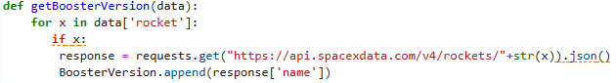
Data Collection – SpaceX API
Make a get request to the SpaceX API. Also do some disputes and basic data formatting.
Import Libraries and Define Auxiliary Functions
Define a series of auxiliary functions that will help us use the API to extract information using identification numbers in the launch data. From the rocket column we would like to learn the booster name.

Slide 9
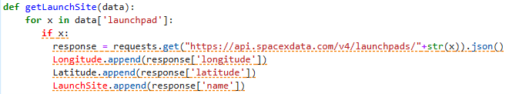
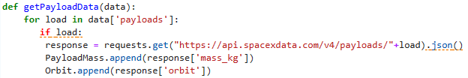
Data Collection – SpaceX API
From the launchpad we would like to know the name of the launch site being used, the longitud, and the latitude.
From the payload we would like to learn the mass of the payload and the orbit that it is going to.

Slide 10
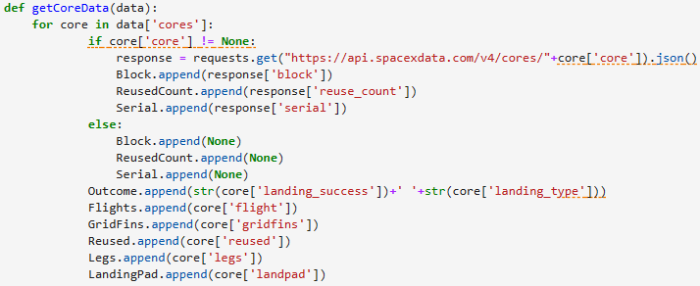
Data Collection – SpaceX API
From cores we would like to learn:
the outcome of the landing
the type of the landing
number of flights with that core
whether gridfins were used
wheter the core is reused
wheter legs were used
the landing pad used
the block of the core which is a number used to seperate version of cores
the number of times this specific core has been reused
the serial of the core.

Slide 11
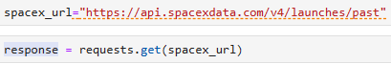
Data Collection – SpaceX API
Now let's start requesting rocket launch data from SpaceX API with the following URL:

Slide 12
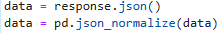
Data Collection – SpaceX API
1° Step: Request and analyze SpaceX launch data using the GET request
Use the following static response object for this project:
static_json_url='https://cf-courses-data.s3.us.cloud-object-storage.appdomain.cloud/IBM- DS0321EN-SkillsNetwork/datasets/API_call_spacex_api.json'
decode the response content as a Json using .json() and turn it into a Pandas dataframe using .json_normalize()

Slide 13
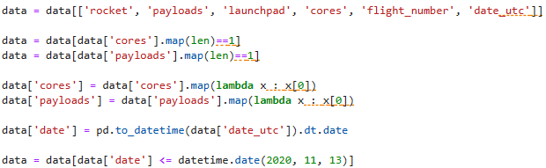
Data Collection – SpaceX API
You will notice that a lot of the data are IDs.
Use the API again to get information about the launches using the IDs given for each launch. Specifically we will be using columns rocket, payloads, launchpad, and cores.
apply getBoosterVersion function method to get the booster version

Slide 14
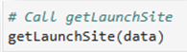
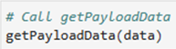
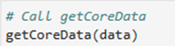
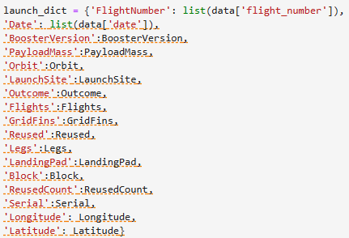
Data Collection – SpaceX API
apply the rest of the functions
Finally lets construct our dataset using the data we have obtained.

Slide 15
Data Collection – SpaceX API
Create a Pandas data frame from the dictionary launch_dict.

Slide 16
Data Collection – SpaceX API
We will be introduced in the "Data Wrangling" little by little
2° Step: Filter the dataframe to only include Falcon 9 launches
We remove the Falcon 1 launches keeping only the Falcon 9 launches.
Filter the data dataframe using the BoosterVersion column to only keep the Falcon 9 launches.
Save the filtered data to a new dataframe called data_falcon9

Slide 17
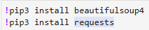
Data Collection - Scraping
import required packages for this lab
IBM provided some helper functions for you to process web scraped HTML table
To maintain consistency of lab tasks, you were asked to scrape data from a snapshot of the Falcon 9 and Falcon Heavy Wikipage Launch List updated on June 9, 2021
static_url = "https://en.wikipedia.org/w/index.php?title=List_of_Falcon_9_and_Falcon_Heavy_launches&oldid=1027686922"

Slide 18
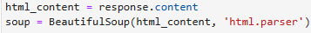
Data Collection - Scraping
1° Step: Extract all column/variable names from the HTML table header
Let's perform an HTTP GET method to request the Falcon9 Launch HTML page, as an HTTP response
Create a BeautifulSoup object from the HTML response

Slide 19
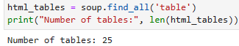
Data Collection - Scraping
2° Step: Extract all column/variable names from the HTML table header
We want to collect all relevant column names from the HTML table header.
Let's try to find all tables on the wiki page first.
Starting from the third table is our target table contains the actual launch records.

Slide 20
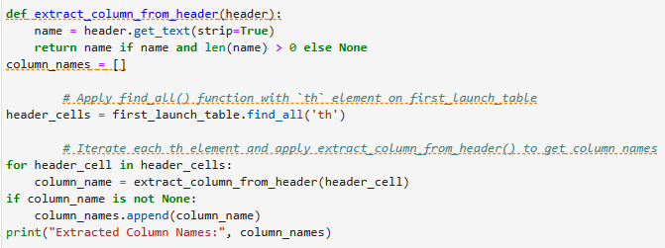
Data Collection - Scraping
we just need to iterate through the <th> elements and apply the provided extract_column_from_header() to extract column name one by one

Slide 21
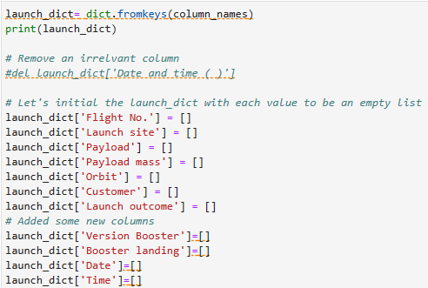
Data Collection - Scraping
3° Step: Create a data frame by parsing the launch HTML tables
We create an empty dictionary with keys from the extracted column names previously.
Later, this dictionary will be converted into a Pandas dataframe.

Slide 22
Data Collection - Scraping
3° Step: Create a data frame by parsing the launch HTML tables
Next, we just need to fill up the launch_dict with launch records extracted from table rows.
Usually, HTML tables in Wiki pages are likely to contain unexpected annotations and other types of noises, such as reference links B0004.1[8], missing values N/A [e], inconsistent formatting, etc.
To simplify the parsing process, IBM provided an incomplete code snippet below to help you to fill up the launch_dict
once, you complete the helping code you can create a dataframe from it

Slide 23
Data Wrangling
Import Libraries and Define Auxiliary Functions
Import Pandas and Numpy
Load Space X dataset, from last section
Identify and calculate the percentage of the missing values in each attribute

Slide 24
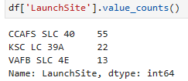
Data Wrangling
1° Step: Calculate the number of launches on each site
Use the method “value_counts()” on the column “LaunchSite” to determine the number of launches on each site:

Slide 25
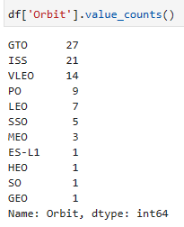
Data Wrangling
2° Step: Calculate the number and occurrence of each orbit
Use the method “.value_counts()” to determine the number and occurrence of each orbit in the column “Orbit”:

Slide 26
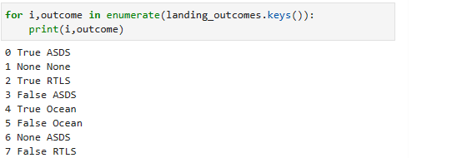
Data Wrangling
3° Step: Calculate the number and occurence of mission outcome per orbit type
Use the method “.value_counts()” on the column “Outcome” to determine the number of “landing_outcomes”. Then assign it to a variable “landing_outcomes”.
True ASDS means the mission outcome was successfully landed to a drone ship
None None these represent a failure to land
True RTLS means the mission outcome was successfully landed to a ground pad
False ASDS means the mission outcome was unsuccessfully landed to a drone ship.
True Ocean means the mission outcome was successfully landed to a specific region of the ocean.
False Ocean means the mission outcome was unsuccessfully landed to a specific region of the ocean.
None ASDS and None None these represent a failure to land.
False RTLS means the mission outcome was unsuccessfully landed to a ground pad.

Slide 27
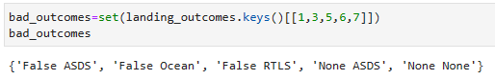
Data Wrangling
3° Step: Calculate the number and occurence of mission outcome per orbit type
create a set of outcomes where the second stage did not land successfully

Slide 28
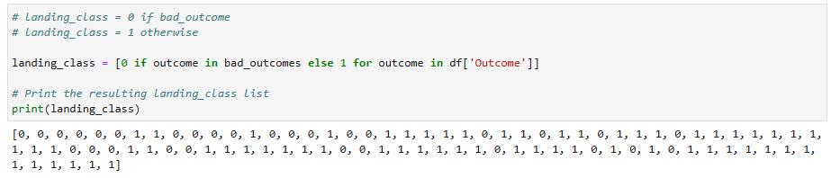
Data Wrangling
4° Step: Create a landing outcome label from Outcome column
Using the Outcome, create a list where the element is zero if the corresponding row in “Outcome” is in the set “bad_outcome”; otherwise, it's one. Then assign it to the variable “landing_class”

Slide 29
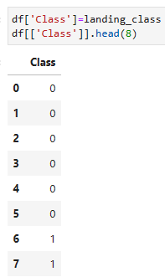
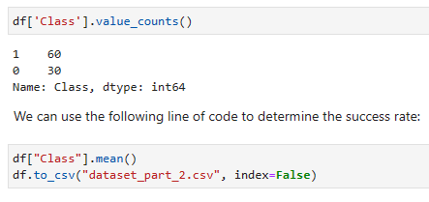
Data Wrangling
4° Step: Create a landing outcome label from Outcome column
“landing_class” represent the classification variable that represents the outcome of each launch. If the value is zero, the first stage did not land successfully; one means the first stage landed Successfully

Slide 30
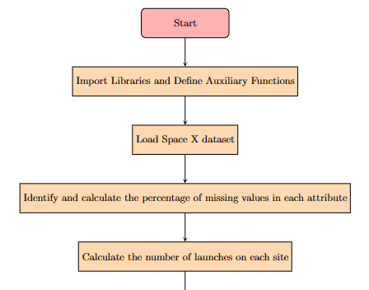
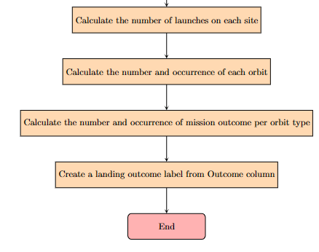
Data Wrangling
DataScience/Week1/Spacex-Data wrangling.ipynb at main · IvannFerre/DataScience (github.com)

Slide 31
EDA with Data Visualization
Plot Flight Number vs Launch Site: The Flight Number vs Launch Site graph shows you the frequency and distribution of launches at each launch site over time
Plot Payload Mass vs. Launch Site: The Payload Mass vs Launch Site graph shows you the relationship between payload mass and launch site, which can indicate the capability and performance of each site.
Plot Success Rate vs. Orbit: The Success Rate vs Orbit graph shows you the success rate of launches as a function of orbit type, which can reveal the challenges and risks associated with each orbit.
Plot Flight Number vs. Orbit: The Flight Number vs Orbit graph shows you the evolution and diversity of SpaceX missions in different orbits over time.
Plot Payload Mass vs. Orbit: The Payload Mass vs Orbit graph shows you the relationship between payload mass and orbit type, which can reflect the demands and requirements of each orbit.
Plot Success Rate vs. YEARS: The Success Rate vs Years graph shows you the trend and progress of SpaceX's successful launches over the years.
DataScience/Week2/EDA Data Visualization.jupyterlite.ipynb at main · IvannFerre/DataScience (github.com)

Slide 32
EDA with SQL
1° SQL query: Display the names of the unique launch sites in the space mission
2° SQL query: Display 5 records where launch sites begin with the string 'CCA’
3° SQL query: Display the total payload mass carried by boosters launched by NASA (CRS)
4° SQL query: Display average payload mass carried by booster version F9 v1.1
5° SQL query: List the date when the first succesful landing outcome in ground pad was acheived.
DataScience/Week2/EDA SQL .ipynb at main · IvannFerre/DataScience (github.com)

Slide 33
EDA with SQL
6° SQL query: List the names of the boosters which have success in drone ship and have payload mass greater than 4000 but less than 6000
7° SQL query: List the total number of successful and failure mission outcomes
8° SQL query: List the names of the booster_versions which have carried the maximum payload mass.
9° SQL query: List the records which will display the month names, failure landing_outcomes in drone ship ,booster versions, launch_site for the months in year 2015.
10° SQL query: Rank the count of landing outcomes (such as Failure (drone ship) or Success (ground pad)) between the date 2010-06-04 and 2017-03-20, in descending order.

Slide 34
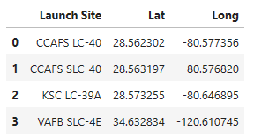
Build an Interactive Map with Folium
First, let's try to add each site's location on a map using site's latitude and longitude coordinates.
we create a dataframe called "launch_sites"
Let's visualize those locations by pinning them on a map.

Slide 35
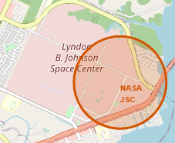
Build an Interactive Map with Folium
Need to create a folium Map object, with an initial center location to be NASA Johnson Space Center at Houston, Texas.
We could use folium.Circle to add a highlighted circle area with a text label on a specific coordinate.

Slide 36
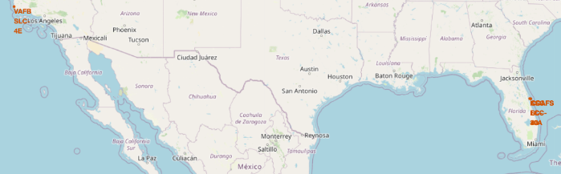
Build an Interactive Map with Folium
Now, we add a circle for each launch site in the data frame “launch_sites”
DataScience/Week3/Interactive Visual Analytics with Folium lab.jupyterlite.ipynb at main · IvannFerre/DataScience (github.com)

Slide 37
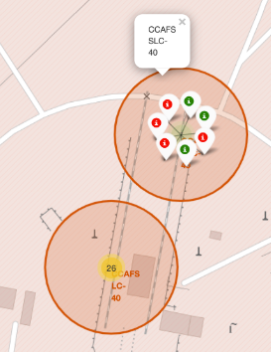
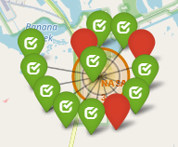
Build an Interactive Map with Folium
Mark the success/failed launches for each site on the map
Let's create markers for all launch records. If a launch was successful (class=1), then we use a green marker and if a launch was failed, we use a red marker (class=0)

Slide 38
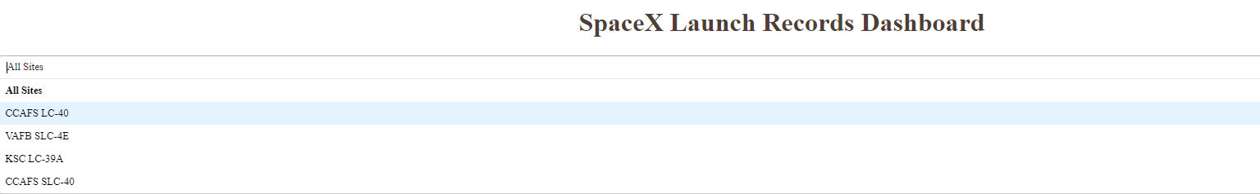
Build a Dashboard with Plotly Dash
We want add a launch site drop-down input component. We have four different launch sites and we would like to first see which one has the largest success count. Then, we would like to select one specific site and check its detailed success rate (class=0 vs. class=1).

Slide 39
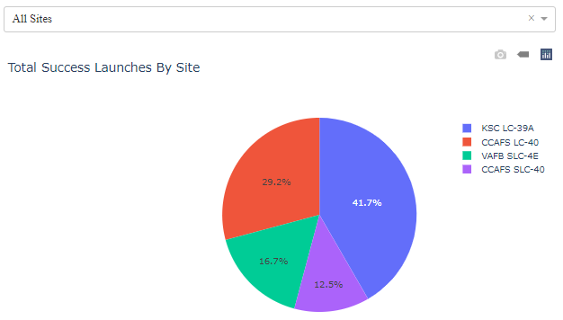
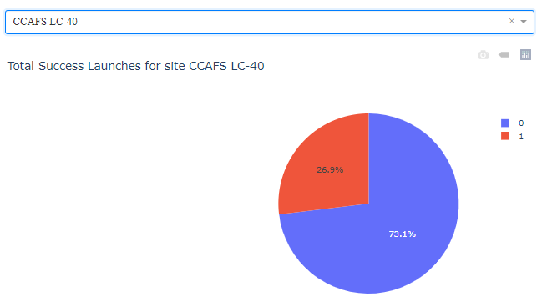
Build a Dashboard with Plotly Dash
Add a callback function to render success-pie-chart based on selected site dropdown. The general idea of this callback function is to get the selected launch site from site-dropdown and render a pie chart visualizing launch success counts.

Slide 40
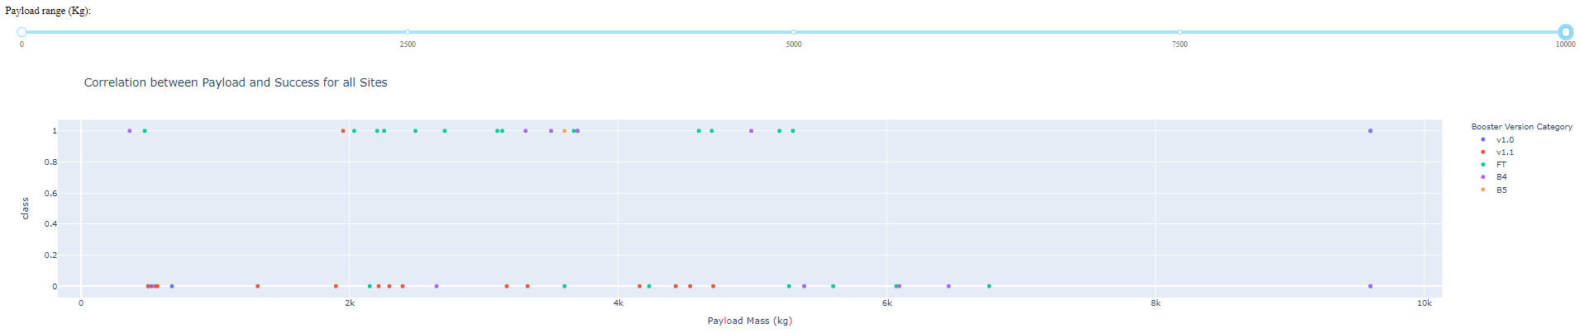
Build a Dashboard with Plotly Dash
Add a callback function to render the success-payload-scatter-chart scatter plot. We want to plot a scatter plot with the x axis to be the payload and the y axis to be the launch outcome.
As such, we can visually observe how payload may be correlated with mission outcomes for selected site(s)

Slide 41
Predictive Analysis (Classification)
Data Preparation:
Create a column for the class.
Standardize the data.
Split into training and test data.
Model Building:
Use classification algorithms like SVM, classification trees, and logistic regression.
Hyperparameter Tuning:
Find the best hyperparameters for each model.

Slide 42
Predictive Analysis (Classification)
Evaluation:
Evaluate model performance using test data.
Comparison:
Determine which method performs best.
DataScience/Week4/SpaceX Machine Learning Prediction.jupyterlite.ipynb at main · IvannFerre/DataScience (github.com)

Slide 43
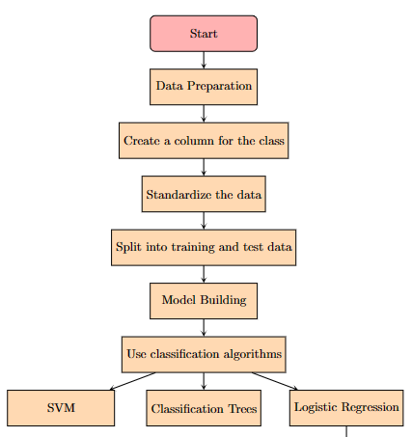
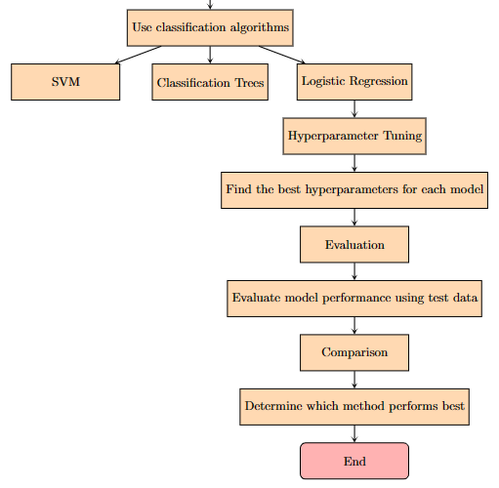
Predictive Analysis (Classification)

Slide 44
Results
Predictive analysis results
The logistic regression model has an accuracy of 97.2% and an area under the ROC curve of 0.99. This means that the model can correctly predict the success or failure of a SpaceX rocket landing in most cases.
The model identifies the most important variables for predicting the landing outcome. These are: mission, rocket type, number of engines, number of previous landings, and orbit type.
The model shows that there is a positive relationship between landing success and the number of previous landings. This indicates that SpaceX has improved its technology and experience over time.
The model also shows that there is a negative relationship between landing success and orbit type. This suggests that higher and more complex orbits are more difficult to achieve and require more fuel and precision.

Slide 45

Section 2

Slide 46
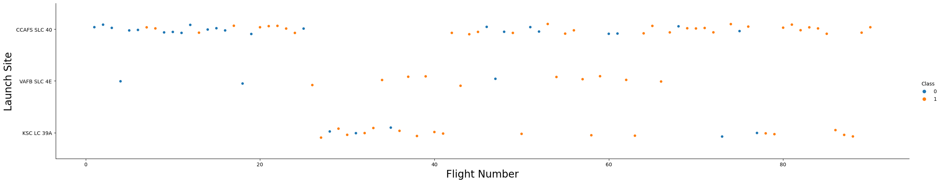
Flight Number vs. Launch Site
CCAFS LC-40 has a success rate of 60%, while KSC LC-39A and VAFB SLC 4E have a success rate of 77%.
There is no clear linear relationship between Flight Number and Launch Site. The data points are scattered without a distinct trend.
The color coding (orange for Class 1 and blue for Class 2) does not reveal any specific pattern

Slide 47
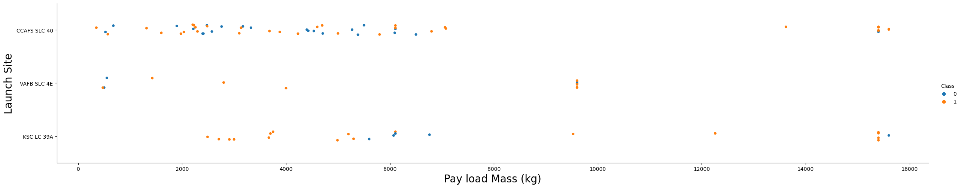
Payload vs. Launch Site

Slide 48
Payload vs. Launch Site
VAFB-SLC (Vandenberg Air Force Base):
For this launch site, there are no rockets launched with a payload mass greater than 10,000 kg.
Most of the successful launches from VAFB-SLC fall within the payload mass range of 1952 kg to 5300 kg.
The absence of heavy payloads suggests that VAFB-SLC may not be optimized for launching larger payloads.
2. Other Launch Sites:
Other launch sites (such as CCAFS LC-40 and KSC LC-39A) have a broader range of payload masses.
The success rate varies across different payload masses for these sites.
Generally, as payload mass increases, the likelihood of successful first-stage landings decreases.

Slide 49
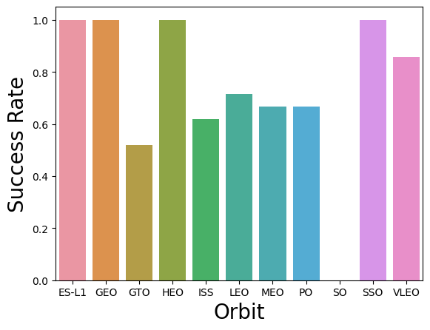
Success Rate vs. Orbit Type
VLEO (Very Low Earth Orbit): VLEO has the highest success rate, approximately 95%. Rockets launched into this orbit have a high likelihood of success.
LEO (Low Earth Orbit): LEO also has a good success rate, around 85%. It’s a common orbit for satellites and space missions.
GEO (Geostationary Earth Orbit): GEO has a moderate success rate, approximately 75%. It’s used for communication and weather satellites.
MEO (Medium Earth Orbit): MEO has a success rate of about 70%. Navigation satellites often operate in this orbit.
ISS (International Space Station): The ISS orbit has a success rate of around 65%. It’s a challenging orbit due to rendezvous and docking requirements.
ES-L1 (Earth-Sun Lagrange Point 1): ES-L1 has a lower success rate, approximately 60%. It’s used for solar observatories.

Slide 50
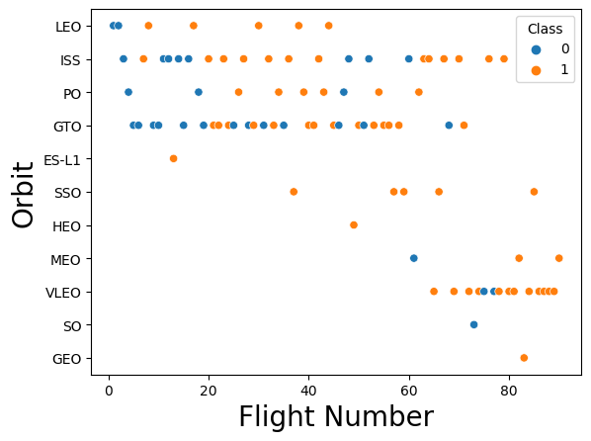
Flight Number vs. Orbit Type
LEO (Low Earth Orbit):
High concentration of successful launches (orange dots) at lower flight numbers.
Indicates a positive correlation between flight number and success rate in LEO.
GTO (Geostationary Transfer Orbit):
No clear pattern between flight number and success rate.
Success rates vary without a consistent trend.
Other Orbits (PO, ES-L1, HEO, SEO, MEO, SO, GEO):
Some outliers in both classes.
No strong relationship between flight number and success rate.

Slide 51
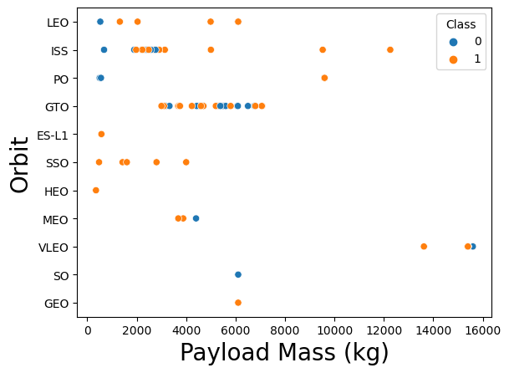
Payload vs. Orbit Type
Observations:
For certain orbits (e.g., LEO), success appears related to the number of flights (more blue dots at higher payload masses).
In other orbits (e.g., GTO), there seems to be no clear relationship between flight number and payload mass.

Slide 52
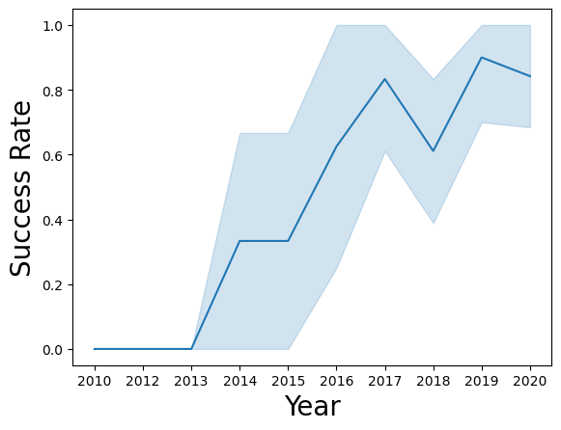
Launch Success Yearly Trend
Overall, the success rate has increased over time.
There is a slight drop in the success rate between 2017 and 2019.
The highest success rate is in 2019, around 90%.
The lowest success rate is in 2010 to 2013, around 0%.

Slide 53
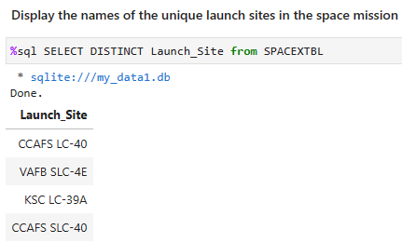
All Launch Site Names
The query is "SELECT DISTINCT Launch_Site from SPACEXTBL". The result is a table with one column, "Launch_Site", and four rows: "CCAFS LC-40", "VAFB SLC-4E", "KSC LC-39A", and "CCAFS SLC-40".
The purpose of the query is to display the names of the unique launch sites on the space mission.

Slide 54
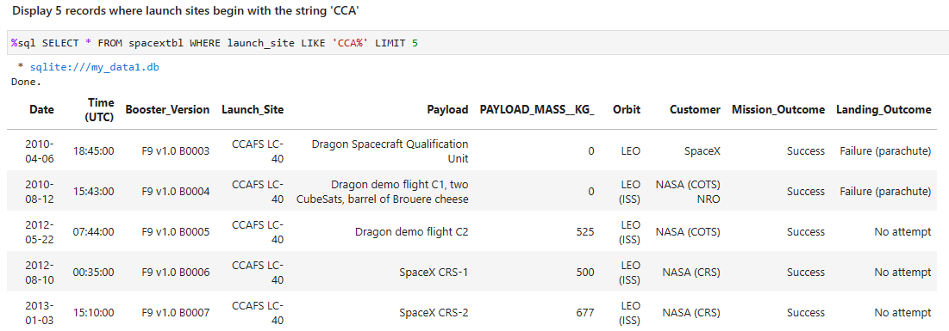
Launch Site Names Begin with 'CCA'
The image shows a SQL query that is used to filter records that have launch sites that start with the string 'CCA'.

Slide 55
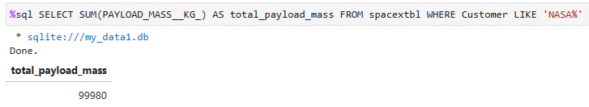
Total Payload Mass
Calculate the total payload carried by boosters from NASA
La consulta busca la suma de la masa de carga útil de todos los lanzamientos de SpaceX que tienen a la NASA como cliente. La salida es “total_payload_mass” es 99800. Esto significa que la masa total de carga útil que SpaceX ha enviado al espacio para la NASA es de 99800 kilogramos.

Slide 56
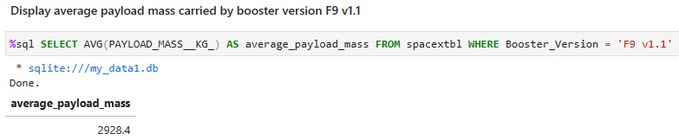
Average Payload Mass by F9 v1.1
Looks for the average payload mass of the F9 v1.1 version of space rockets. The result is 2928.4 kilograms. This means that, on average, the rockets in this version can carry almost 3 tons of payload into space.

Slide 57
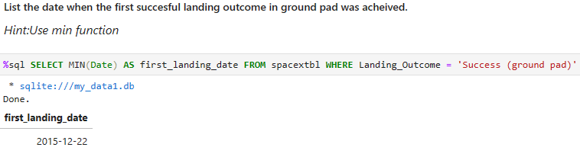
First Successful Ground Landing Date
The SQL query uses the MIN() function and the WHERE clause to get the minimum date value between rows that have the value "Success (ground pad)" in the Landing_Outcome column.

Slide 58
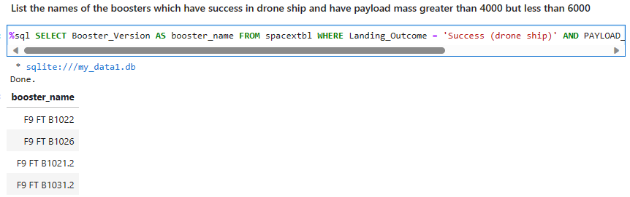
Successful Drone Ship Landing with Payload between 4000 and 6000
The SQL query shown in the image is selecting the thruster versions from a table where the landing result is "Success (drone ship)" and the payload mass is between 4000 and 6000 pounds.

Slide 59
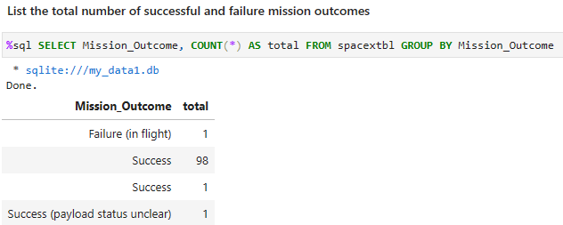
Total Number of Successful and Failure Mission Outcomes
The query result is a table with three rows and two columns, which shows the total number of results for each type of mission result. This means that there was only one in-flight failure, 98 successes, and one success with the payload status unclear.

Slide 60

Boosters Carried Maximum Payload
The result of the query is a list of versions and names of thrusters that have carried the maximum payload mass

Slide 61

Rank Landing Outcomes Between 2010-06-04 and 2017-03-20
The query result is a table with two columns, which shows the total number of results for each type of landing result. This means that there were 10 launches with no landing attempt, 5 successful landings on a land platform, 5 failures on an offshore platform, etc.

Slide 62

Section 3

Slide 63

NASA’s Rocket Launch
We used Folium to create an interactive map with circles and markers representing NASA's rocket launch sites. The result of this code is a map showing four launch sites in different colors and with labels indicating their names.

Slide 64

Successful and Unsuccessful Launches
The result we will get is an interactive map showing the SpaceX launch locations and the outcome of each launch. Green markers with a checkmark indicate successful throws, while red markers with a cross indicate failed throws.By clicking on a bookmark, we can see more information about the launch

Slide 65

Distances
We calculate the distance between the launch site and the nearest shoreline, and create a marker with that distance on the map.

Slide 66

Section 4

Slide 67
Successful Launches
The site with the most successful launches is KSC LC-39A, which takes up most of the chart.
The site with the fewest successful launches is CCAFS SLC-40, which takes up the smallest part of the chart.

Slide 68
Correlation between Payload Mass and Success
This is a correlation graph between payload mass and successful launches based on the type of booster version used. A large majority of the FT category has been a success, and conversely much of the v1.1 category has failed. There is no correlation between these two features

Slide 69

Section 5

Slide 70

Classification Accuracy
All four models have a similar accuracy, around 0.8, indicating that they are able to correctly classify most cases.
KNN is clearly superior to the others.
Accuracy is not the only criterion for evaluating a classification model, other aspects such as speed, interpretability or robustness could also be considered

Slide 71

KNN Confusion Matrix
The model has a high accuracy in predicting that the object did not land, as the upper left cell is the darkest and has the highest number of correct predictions.
The model has a low accuracy in predicting that the object landed, as the bottom right cell is the clearest and has the fewest correct predictions.
The model has a false positive problem, as the top right cell is darker than the bottom left cell, meaning the model predicted more times that the object landed when it actually didn't.

Slide 72
Conclusions
SpaceX's project could be interested in developing a classification system that can detect whether a rocket or space capsule has successfully landed or not, based on data such as speed, altitude, pressure, temperature, etc.
The classification system could be useful for evaluating the performance of space missions, identifying potential failures or anomalies, and improving the safety and efficiency of launches and landings.
The graphs show that all four classification models have a similar accuracy, around 0.8, indicating that they are able to correctly classify most cases. However, none of the models are perfect, and they all have some classification errors.
The graphs also show that the model that has the biggest problem with false positives is the K Nearest Neighbors, as it predicts more times that the object landed when it actually didn't. This could be a risk for SpaceX's project, as it could lead to a false sense of success or a loss of valuable information about the causes of failure.

Slide 73
Conclusions
The model that has the least false positive problem is the Decision Tree, as it predicts fewer times that the object landed when it actually didn't. This could be an advantage for the SpaceX project, as it could avoid confusion or misunderstandings about the outcome of the missions.
Accuracy is not the only criterion for evaluating a classification model, other aspects such as speed, interpretability or robustness could also be considered. The SpaceX project could choose the simplest model or the one most appropriate to the problem to be solved, taking into account the limitations and requirements of the space context

Slide 74
Appendix
Include any relevant assets like Python code snippets, SQL queries, charts, Notebook outputs, or data sets that you may have created during this project

Slide 75


